Slide 1
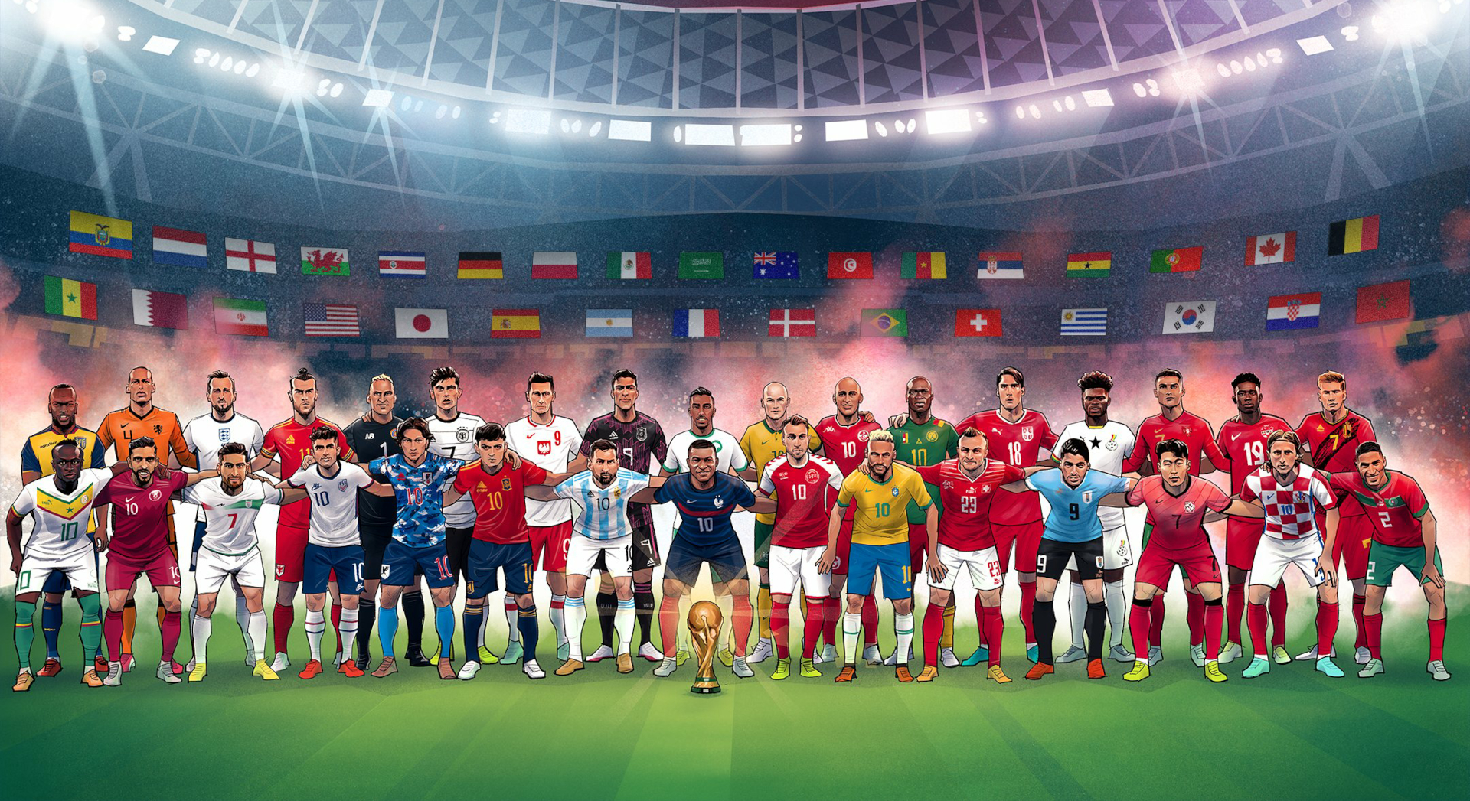
CORRELATION IS CAUSATION
Global Football Diversity:
Exploring the Impact of Multinational Players in World Cups

Slide 2
CORRELATION IS CAUSATION
(NOT)
Global Football Diversity:
Exploring the Impact of Multinational Players in World Cups

Slide 3
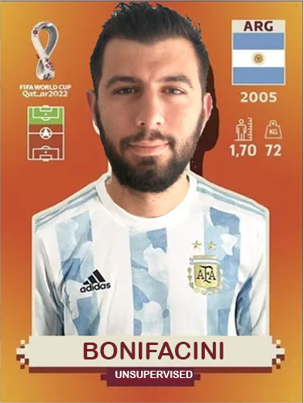
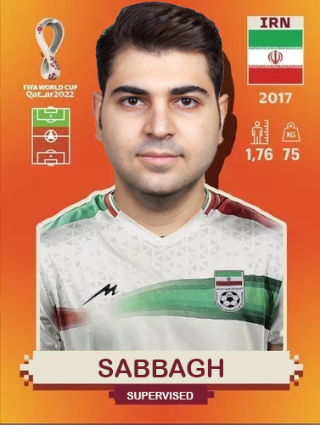
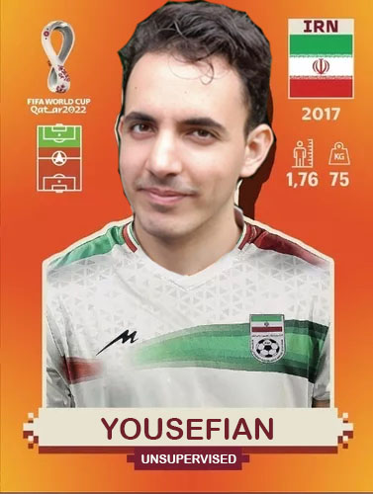
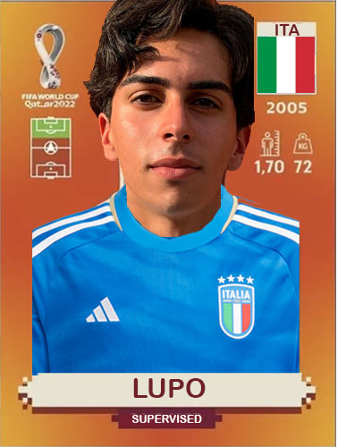
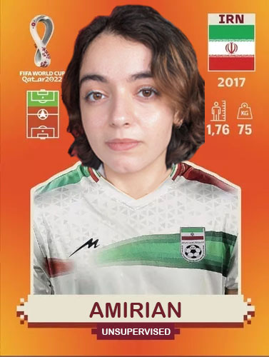
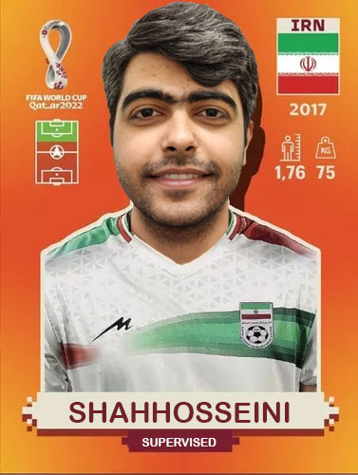
PLAYERS

Slide 4
CONTENTS
Introduction
Datasets
Exploratory Data Analysis
Unsupervised results
Supervised results
Conclusion

Slide 5

“
"Statistics are just a pattern of information that we have. There are players who make the team play good without the statistics. If you perform to your maximum, if you perform to your best and you helped your team-mates and make the process better, it is enough."
Pep Guardiola

Slide 6

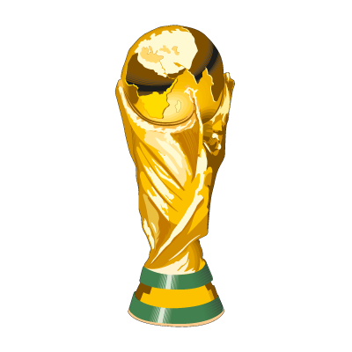

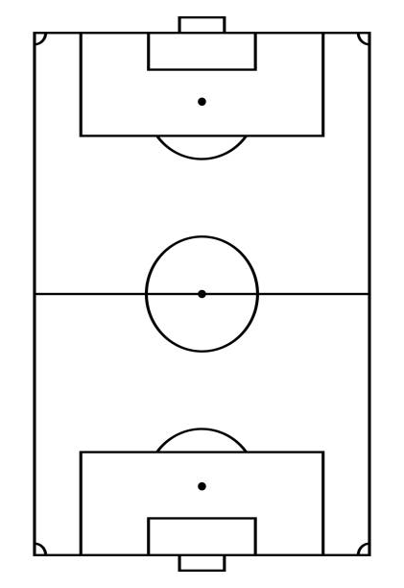

INTRODUCTION
Objective: show that the inclusion of players with nationalities different from their country of origin affects the performance of national teams in the FIFA World Cup.
Question: Does the presence of players who represent a country different from their country of origin influence the performance of national teams in the FIFA World Cup?
Methodology:
Unsupervised learning
Supervised learning

Slide 7
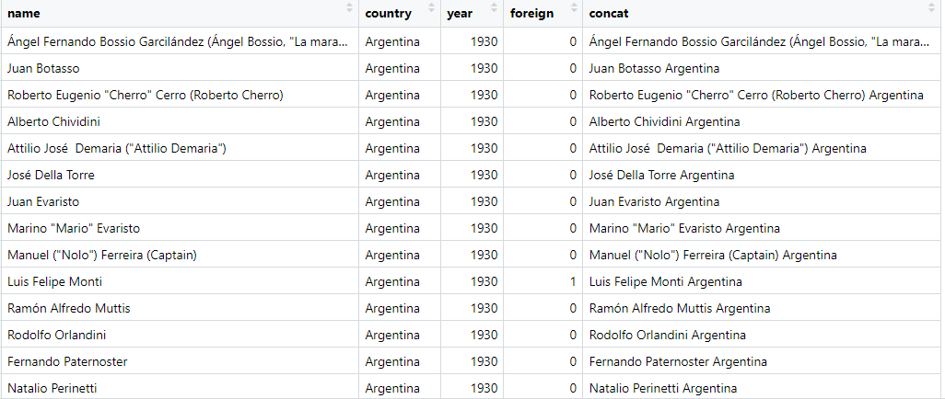

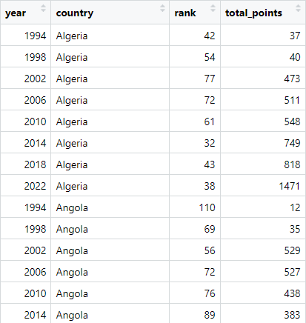
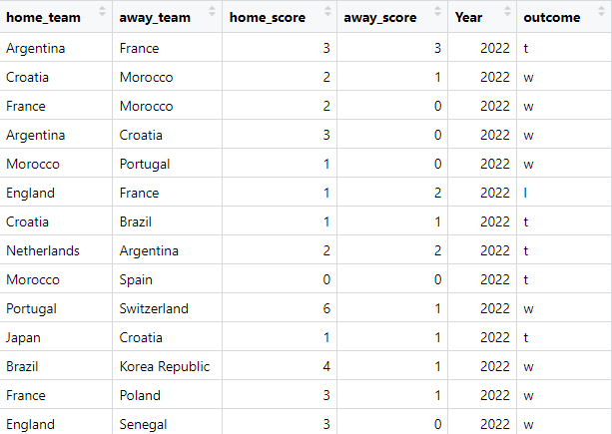

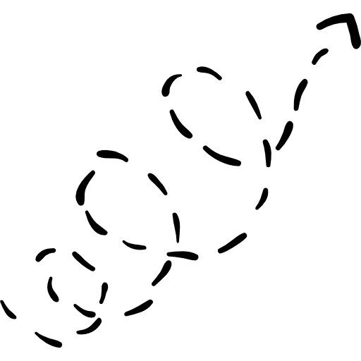
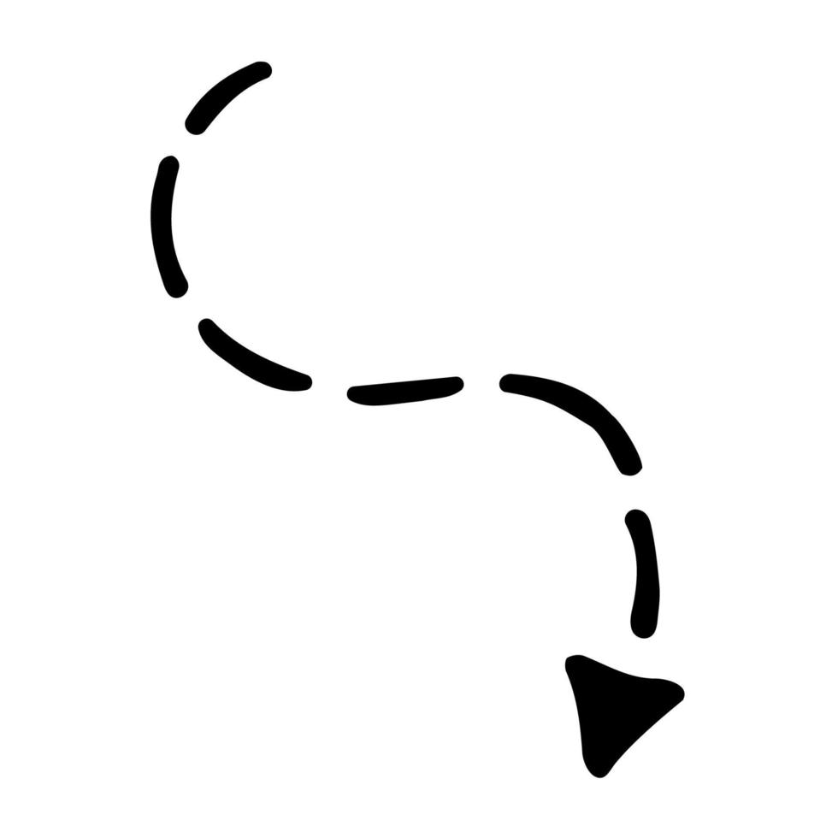
DATASETS
Rows: 10.137
Columns: 5
FINAL
DATASET
DATA
CLEANING
DATA
MANIPULATION
DATASETS
Rows: 596
Columns: 5
Rows: 964
Columns: 6

Slide 8
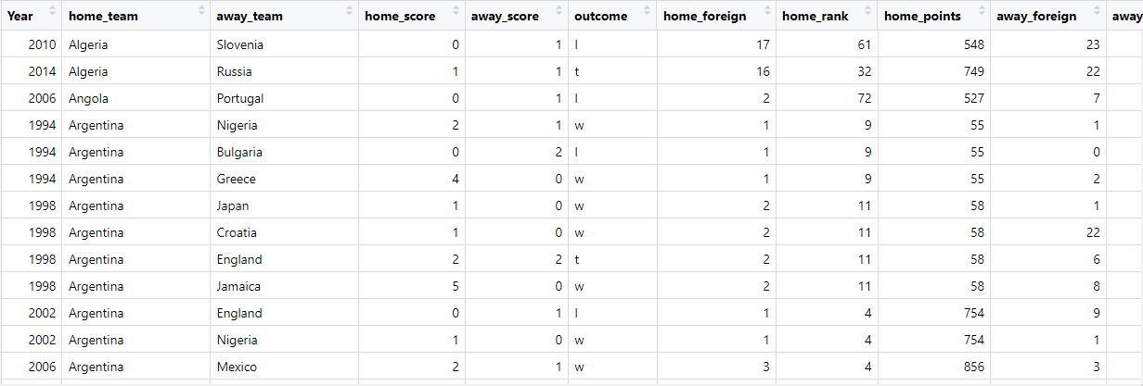
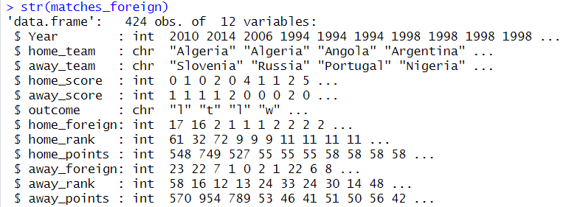
FINAL DATASET - UNSUPERVISED
FINAL
DATASET
DATA
CLEANING
DATA
MANIPULATION
DATASETS

Slide 9
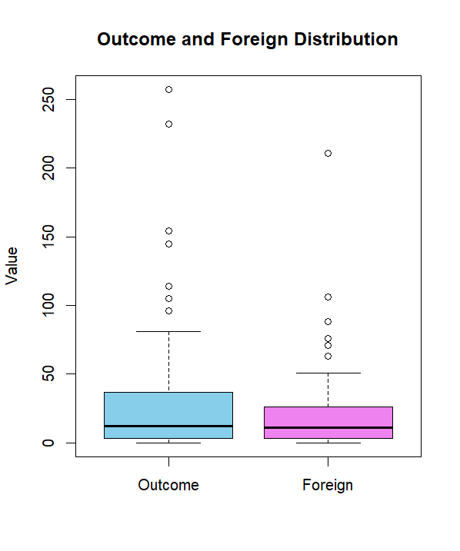
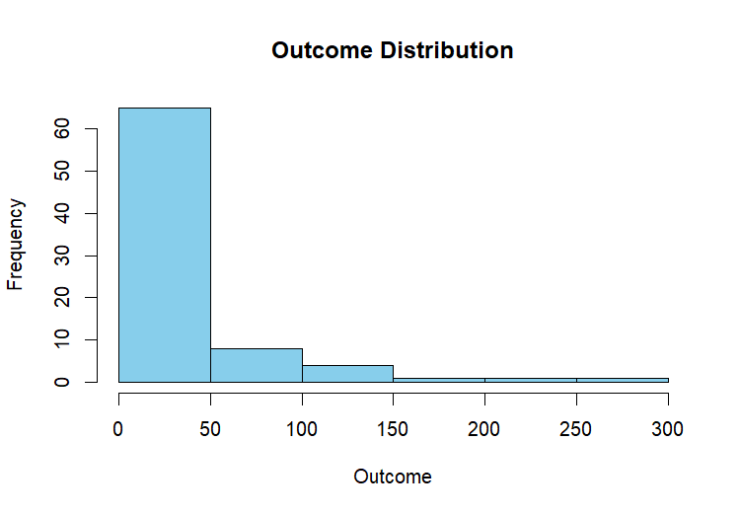
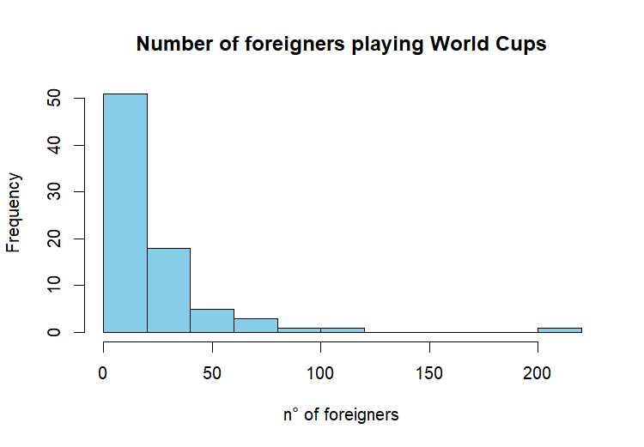
EDA - DISTRIBUTION

Slide 10
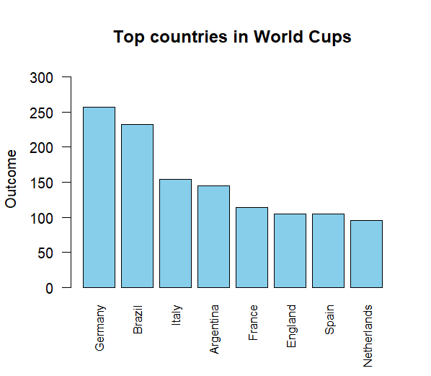
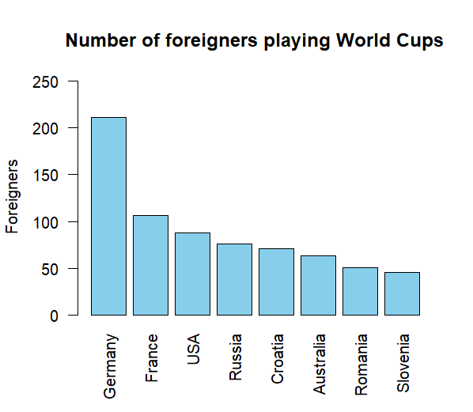
EDA – TOP 8

Slide 11
FINAL DATASET - SUPERVISED
FINAL
DATASET
DATA
CLEANING
DATA
MANIPULATION
DATASETS

Slide 12
UNSUPERVISED

Slide 13
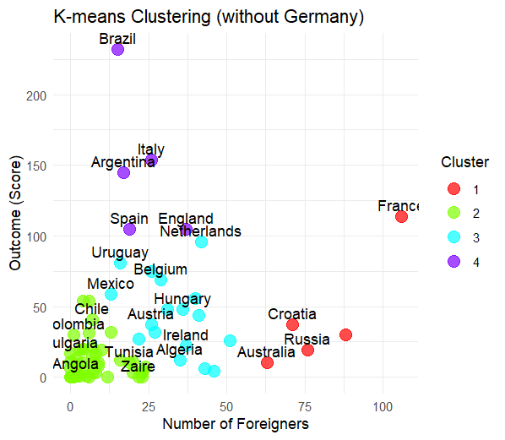
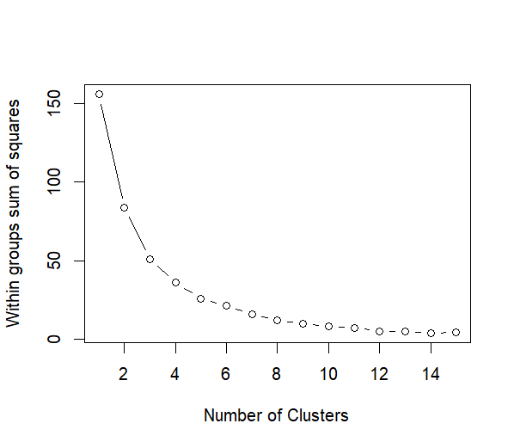
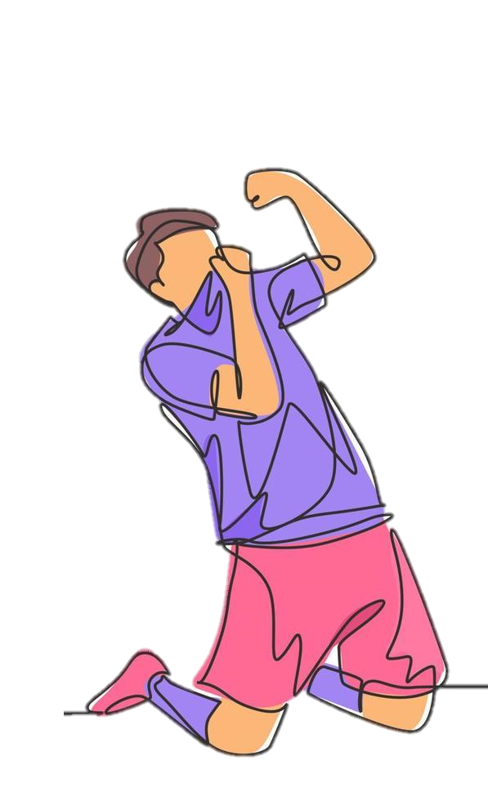
K-MEAN
K = 4
Germany is an outlier in both variables, so we excluded

Slide 14
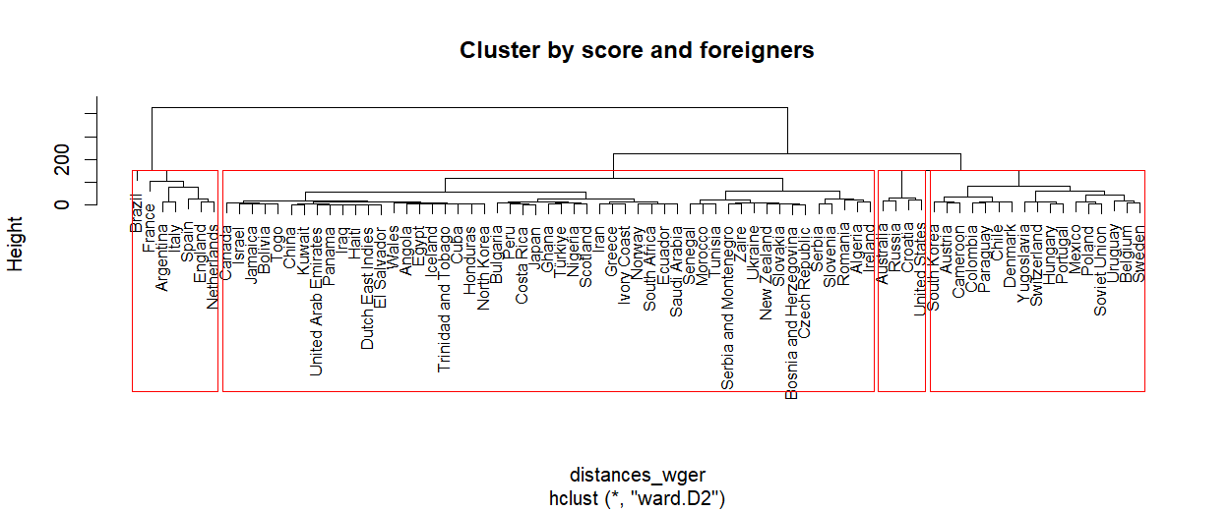
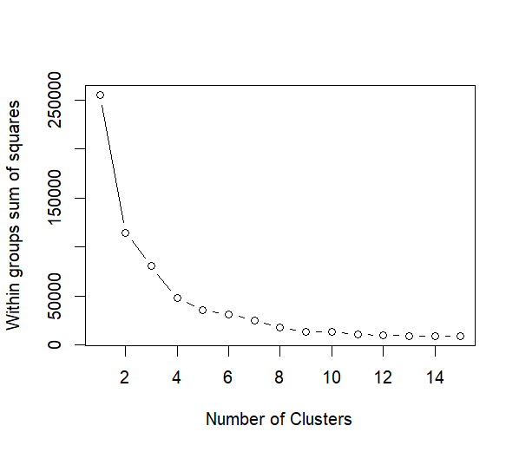
DENDOGRAM
K = 4
Germany is an outlier in both variables, so we excluded

Slide 15
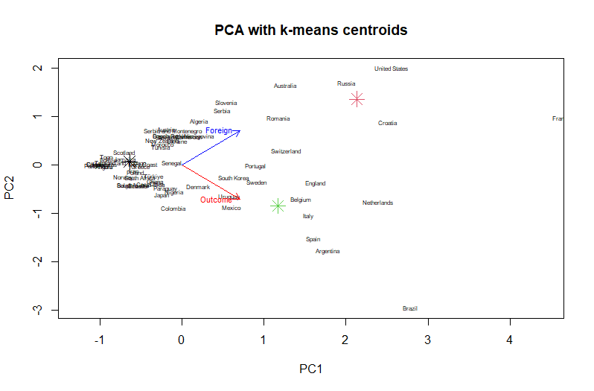
PCA

Slide 16
SUPERVISED

Slide 17
METHODS
DECISION TREE
RANDOM FOREST
KNN

Slide 18
ACCURACY
90:00
Method
00:00
Accuracy
Decision Tree | Mercury
Random Forest | Earth
KNN | Jupiter

Slide 19
THANKS!

Slide 20
THANKS!
3

